Slide 1

HAPPINESS PREDICTION
NUTHAN MANIDEEP KUMBHAM

Slide 2

ABSTRACT
The World Happiness Report 2015 dataset contains data on the happiness levels of people in 159 countries around the world. It includes information on a variety of factors that are thought to contribute to happiness, such as economic factors (GDP per capita), social factors (family, health, and freedom), and trust in government. The data also includes a happiness score and a happiness rank for each country. The happiness score and happiness rank are based on a poll in which people were asked to rate their overall happiness on a scale of 0 to 10. The economy, family, health, freedom, trust, and generosity columns contain various measures of those factors. Overall, the World Happiness Report 2015 dataset provides valuable insights into the factors that contribute to happiness and well-being at the national level, and can be used by researchers, policymakers, and others to better understand and promote happiness around the world.

Slide 3
OVERVIEW
This report compares the performance of various machine learning models on the World Happiness Report 2015 dataset. Data Analysis and Linear Regression Analysis have been conducted, and several models such as Logistic Regression, Neural Network, Classification Tree, Random Forest, Bagging, and Boosting have been compared. The dataset contains information on the happiness levels of people in 159 countries around the world and includes a variety of factors that are thought to contribute to happiness. The models have been evaluated based on their accuracy and performance in predicting the happiness scores of countries in the dataset. The report aims to identify the most effective machine learning model for predicting happiness levels in different countries and provide insights into the factors that contribute to happiness and well-being at the national level. The results of the analysis can be used by researchers, policymakers, and others to promote happiness and well-being around the world.

Slide 4
DATA
.
The dataset can be found on Kaggle and it contains data on happiness levels of people in 159 countries around the world. The data is collected in the year 2015 and it includes information on a variety of factors that are thought to contribute to happiness, such as:
Column Name | Description
Country or Region | Name of the country
Happiness Score | A composite score of overall well-being
Economy (GDP per Capita) | Measure of the economic production of a country
Family | Measure of social support
Health (Life Expectancy) | Measure of the health of citizens
Freedom | Measure of freedom to make life choices
Generosity | Measure of generosity of citizens
Trust (Government Corruption) | Measure of trust in government

Slide 5
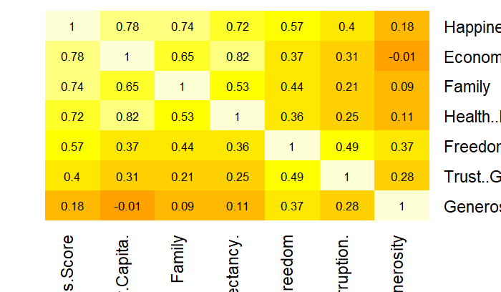
CORRELATION HEATMAP
DATA VISUALIZATION
By examining the heatmap, it is feasible to identify the variables that exhibit a significant correlation with the happiness score, as well as those that do not. The intensity of the color of the cells can reveal the strength of the association between the happiness score and certain factors, such as economy (GDP per Capita), family, health (Life Expectancy), freedom, trust (Government Corruption), and generosity. Thus, darker colored cells in the heatmap would indicate a strong correlation between these variables and the happiness score.

Slide 6
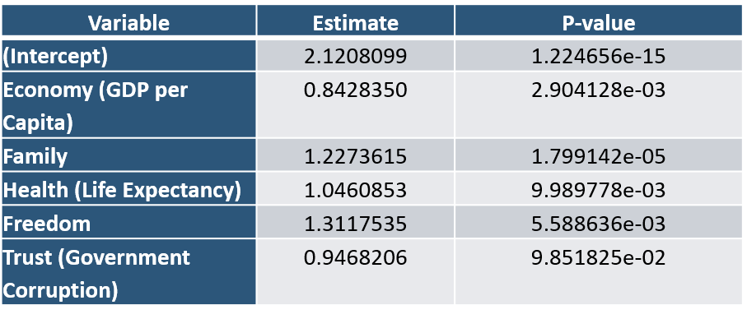
SUMMARY OF LINEAR REGRESSION ANALYSIS
Forward Selection: This method starts with an empty model and iteratively adds one variable at a time, based on a certain criterion, such as the highest p-value. Using this method, one can identify the minimal set of variables that are needed to explain
the response variable.
Backward Elimination: This method starts with a full model that includes all variables and iteratively removes one variable at a time, based on a certain criterion, such as the lowest p-value. Using this method, one can identify the minimal set of variables that are needed to explain the response variable. The best model chosen in this method would be the one that maximizes the p-value of the removed variable.
Best Model is from Forward Selection and Backward Elimination. A linear regression model is fitted by using Economy, Family, Health, Freedom and Trust (Government Corruption). The coefficients of the best model are given in the table.
From the table the Economy, Family, Health, Freedom and Trust are statically significant because the p-value is less than 0.05.

Slide 7
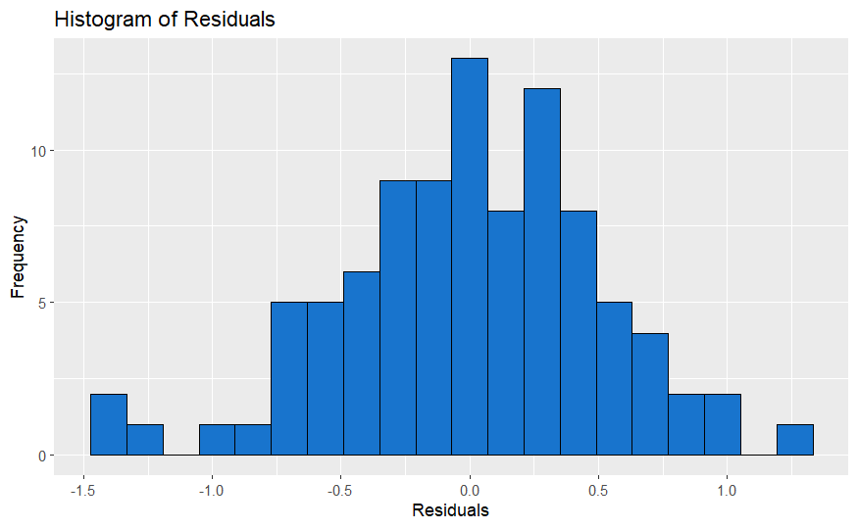
SUMMARY OF LINEAR REGRESSION ANALYSIS
The Accuracy metrics of best model training data are given in the below table
The Histogram residuals of the best model is plotted below.
Metric | Value
ME | 1.946443e-15
RMSE | 5.066885e-01
MAE | 3.930883e-01
MPE | -9.901381e-01
MAPE | 7.956277e+00
The Accuracy metrics of best model validation data are given in the below table.
Metric | Value
ME | -0.07884785
RMSE | 0.59411122
MAE | 0.47625401
MPE | -3.15213018
MAPE | 9.52431748
By observing the histogram of residuals and noting that it closely resembles a normal distribution

Slide 8
SUMMARY OF LOGISTIC REGRESSION
The coefficients of the model-1 are given in the table.
Best Model
The best model in building models is the one that utilizes Economy, Family, Health, Freedom, and Trust (Government Corruption) as its fitting parameters.
From the table the Economy and Family are statically significant because the p-value is less than 0.05.
Variable | Estimate | P-value
(Intercept) | -19.142768 | 0.0007052961
Economy (GDP per Capita) | 7.477746 | 0.0253183052
Family | 6.566475 | 0.0710079997
Health (Life Expectancy) | 5.910844 | 0.1481226606
Freedom | 3.238972 | 0.4162510765
Trust (Government Corruption) | 1.735307 | 0.7592808345
The confusion matrix of best model training data
The model's accuracy is 87.5%, with a specificity of 88.6% and a sensitivity of 86.4%.
 | Predicted Negative (0) | Predicted Positive (1)
Actual Negative (0) | 47 | 6
Actual Positive (1) | 2 | 39
The confusion matrix of best model validation data is given below. The model's accuracy is 81.25%, with a specificity of 81% and a sensitivity of 81%.
 | Predicted Negative (0) | Predicted Positive (1)
Actual Negative (0) | 30 | 7
Actual Positive (1) | 5 | 22

Slide 9
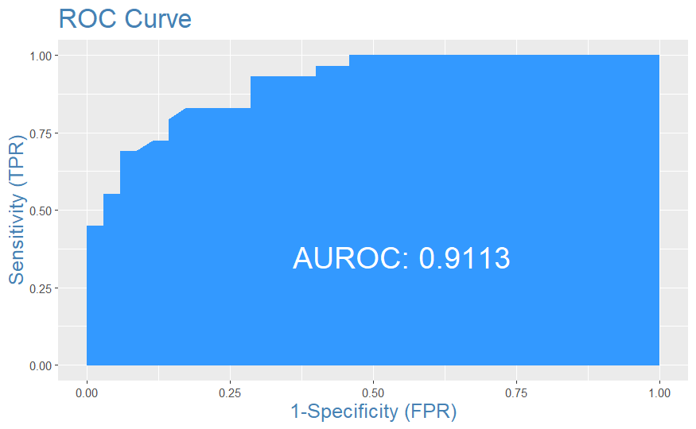
SUMMARY OF LOGISTIC REGRESSION
The plot shows that the model has a high AUC-ROC value of 0.9113, indicating high accuracy in correctly classifying the data with low false positives and false negatives.

Slide 10
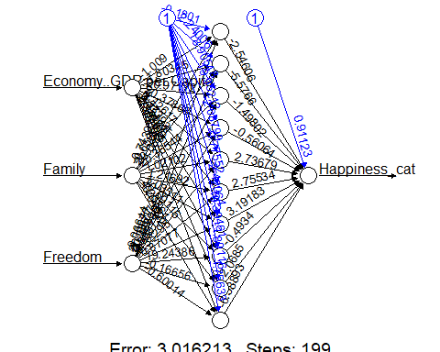
SUMMARY OF NEURAL NETWORK ANALYSIS
The neural network model with 10 neurons and a feature set consisting of Economy(GDP per Capita), Family, and Freedom has been identified as the best model.
The confusion matrix of best model training data
 | Predicted Negative (0) | Predicted Positive (1)
Actual Negative (0) | 46 | 7
Actual Positive (1) | 3 | 38
The model's accuracy is 88%, with a specificity of 87% and a sensitivity of 93%.
The confusion matrix of best model validation data
 | Predicted Negative (0) | Predicted Positive (1)
Actual Negative (0) | 30 | 6
Actual Positive (1) | 5 | 23
The model's accuracy is 81%, with a specificity of 82.14% and a sensitivity of 83.33%.

Slide 11
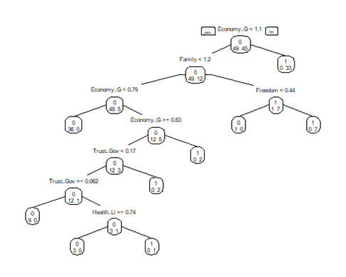
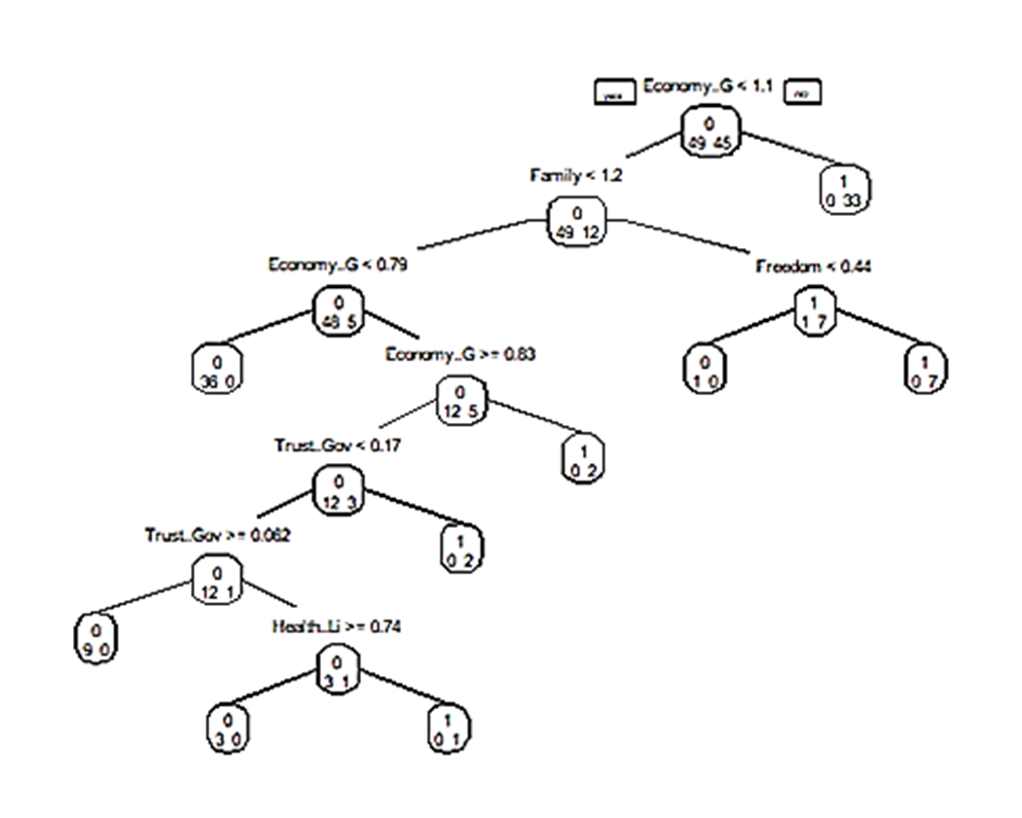
SUMMARY OF CLASSIFICATION TREE, BAGGING, BOOSTING, RANDOM FOREST ANALYSIS
The tree was built with all variables. Variables actually used in tree construction are “Economy..GDP.per.Capita.”, “Family”, “Freedom”, “Health..Life.Expectancy.”, “Trust..Government.Corruption”. The classification tree is shown below:
The confusion matrix of classification tree model for training data
 | Predicted Negative (0) | Predicted Positive (1)
Actual Negative (0) | 49 | 0
Actual Positive (1) | 0 | 45
The model's accuracy is 100%, with a specificity of 100% and a sensitivity of 100%.
The confusion matrix of classification tree for validation data
 | Predicted Negative (0) | Predicted Positive (1)
Actual Negative (0) | 29 | 9
Actual Positive (1) | 6 | 20
The model's accuracy is 76.56%, with a specificity of 68.8% and a sensitivity of 82.86%.

Slide 12
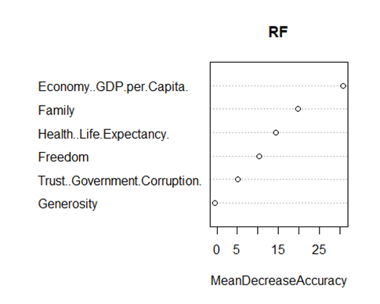
SUMMARY OF CLASSIFICATION TREE, BAGGING, BOOSTING, RANDOM FOREST ANALYSIS
The most important variables in the plot are “GDP”, “Family”, “Life Expectancy”, “Freedom”.
The confusion matrix of random forest model for training data is given below:
 | Predicted Negative (0) | Predicted Positive (1)
Actual Negative (0) | 49 | 3
Actual Positive (1) | 0 | 42
The model's accuracy is 97.87%, with a specificity of 93.33% and a sensitivity of 100%.
The confusion matrix of random forest model for validation data is given below:
 | Predicted Negative (0) | Predicted Positive (1)
Actual Negative (0) | 29 | 9
Actual Positive (1) | 6 | 20
The model's accuracy is 76.96%, with a specificity of 68.97% and a sensitivity of 82.86%.

Slide 13
BAGGING MODEL
Bagging, short for bootstrap aggregating, is ensemble learning method that combines multiple models to improve the accuracy and stability of the predictions. The basic idea is to generate multiple bootstrap samples of the training data, and then train a separate model on each sample.
The confusion matrix for the training data of bagging model is shown below:
 | Predicted Negative (0) | Predicted Positive (1)
Actual Negative (0) | 47 | 5
Actual Positive (1) | 2 | 40
The model's accuracy is 92.55%, with a specificity of 88.89% and a sensitivity of 95.92%.
The confusion matrix for the validation data of bagging model is shown below
 | Predicted Negative (0) | Predicted Positive (1)
Actual Negative (0) | 28 | 9
Actual Positive (1) | 7 | 20
The model's accuracy is 76.56%, with a specificity of 68.97% and a sensitivity of 80%.

Slide 14
BOOSTING MODEL
Boosting is ensemble learning method that combines multiple models to improve the accuracy of the predictions. The basic idea is to train multiple weak models sequentially, and each model is trained on the residuals of the previous model.
The confusion matrix for the training data of boosting model is shown below:
 | Predicted Negative (0) | Predicted Positive (1)
Actual Negative (0) | 46 | 4
Actual Positive (1) | 3 | 41
The model's accuracy is 92.55%, with a specificity of 91.11% and a sensitivity of 93.88%.
The confusion matrix for the validation data of boosting model is shown below
 | Predicted Negative (0) | Predicted Positive (1)
Actual Negative (0) | 27 | 9
Actual Positive (1) | 8 | 20
The model's accuracy is 73.43%, with a specificity of 68.97% and a sensitivity of 77.14%.
The examination shows that out of all the models developed, the random forest model has emerged as the top performer. When used on the validation data, this model shows the highest accuracy, reaching 76.56%.

Slide 15
COMPARISON OF LR, NN AND TREE METHODS
Model Name | Model Description | Validation Accuracy
Logistic Regression Model | Model with 5 predictors Economy, Family, Health, Freedom, and Trust (Government Corruption) | 81.25%
Neural network model | Model with 1 hidden and 10 neurons having of Economy(GDP per Capita), Family, and Freedom. | 81%
Best Classification Tree | Classification tree model with full predictors | 76.56%
Random Forest | Random forest model with all predictors and 500 decision trees. | 76.56%
Bagging | Bagging method with all predictors | 76.56%
Boosting | Boosting method is used to fit all predictors | 73.43%

Slide 16
CONCLUSION
In this analysis, Data Analysis and Multiple Linear Regression and four different models were fitted to predict the happiness score of different countries. The models used were logistic regression, neural network, classification tree, bagging, boosting, and random forest analysis. Overall the best model is Logistic model with Economy, Family, Health, Freedom, and Trust (Government Corruption) as predictors. The model's accuracy for validation data is 81.25%, with a specificity of 81% and a sensitivity of 81%. Overall, the model demonstrates good performance in predicting the outcome of interest, suggesting that the factors included in the model are important predictors.

Slide 17

THANK YOU!

